Slide 1
Local illumination models
Advanced Graphics Programming

Slide 2
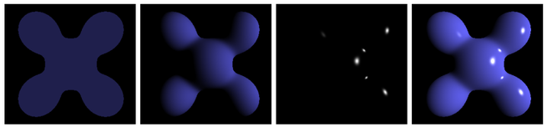
Local illumination models
Ambient Diffuse Specular Result: light sum

Slide 3
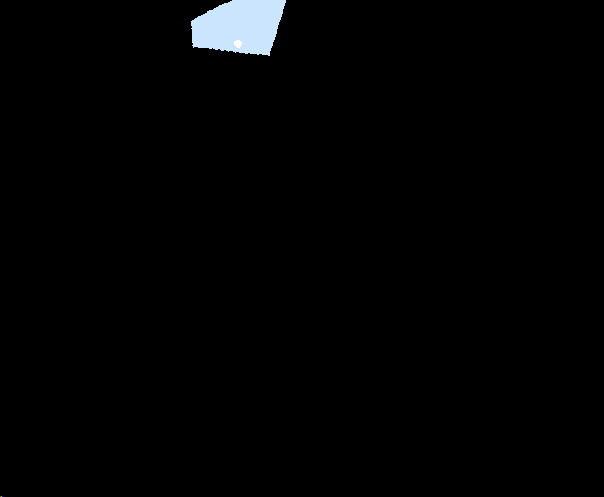
Local illumination models
No light at all
Our shader output
out vec4 outColor;
Initialization
outColor.rgb = vec3(0.0);

Slide 4
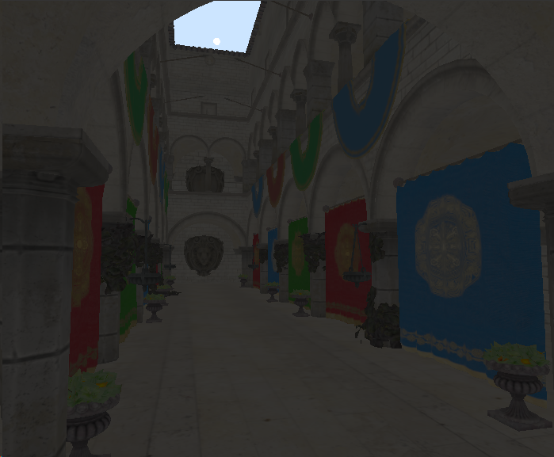
Local illumination models
Ambient lighting
We call ambient lighting the illumination of objects by indirect light rays (no by a direct light source).
However, light comes from everywhere, so this would be a very costly computation.
Fake approximation
float ambientTerm = 0.05;
outColor.rgb += albedo * ambientTerm;

Slide 5
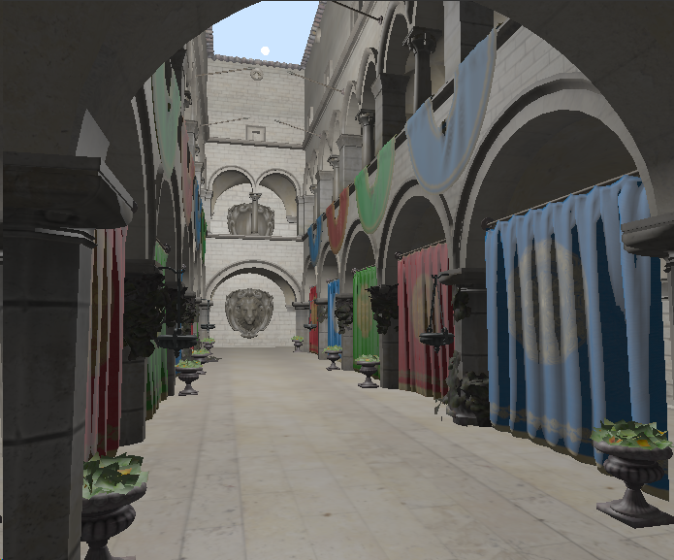
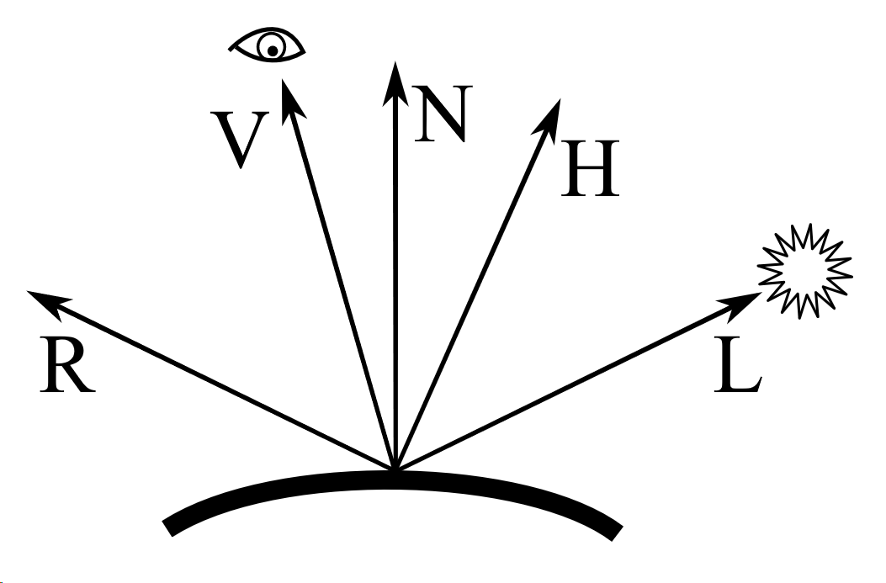

Local illumination models
Phong reflection model
Ambient term (already added)
Diffuse term (Lambertian reflectance)
Specular term using dot(V, R)

Slide 6
Local illumination models
Phong reflection model
Ambient term (already added)
Diffuse term (Lambertian reflectance)
Specular term using dot(V, R)
ambient diffuse specular

Slide 7
Local illumination models
Phong reflection model
Ambient term (already added)
Diffuse term (Lambertian reflectance)
Specular term using dot(V, R)
albedo albedo material specular

Slide 8
Local illumination models
Phong reflection model
Ambient term (already added)
Diffuse term (Lambertian reflectance)
Specular term using dot(V, R)
light color light color light color

Slide 9
Local illumination models
Phong reflection model
Ambient term (already added)
Diffuse term (Lambertian reflectance)
Specular term using dot(V, R)
Lambert specular lobe

Slide 10
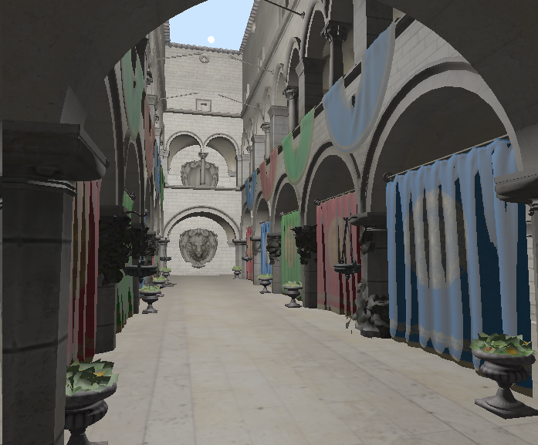
Local illumination models
Blinn-Phong reflection
Ambient term (already added)
Diffuse term (Lambertian reflectance)
Specular term using dot(N, H)
dot(N, H)

Slide 11

Local illumination models
Bump mapping
Bump mapping are a set of techniques to add detail to surfaces by means of textures:
Height fields
Normal maps
Some techniques:
Normal mapping
Parallax mapping
Relief mapping

